Slide 1
Screen Design
Roll nO: 19SW43
Name: Amrat

Slide 2
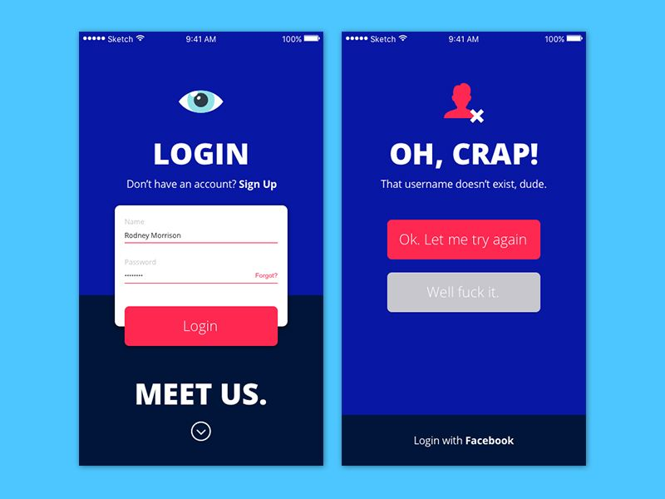
definition
Screen design refers to the graphic design and layout of user interfaces on displays. It is a sub-area of user interface design but is limited to monitors and displays.
Screen design is about making interaction easier for users through a functional yet aesthetic arrangement of all screen elements, whether it is the display of a smartphone or the touch screen of a car navigation system.

Slide 3
Applications of Screen design
Screen design is used in mobile and desktop versions of websites, apps, and any graphical user interface displayed on monitors or displays that enable users to interact with electronic devices. This includes computers, portable media players, gaming devices, smartphones, and household, office, or industrial controls.

Slide 4
Goal of screen design
The goal of screen design is to make user interaction with a software or device as easy and efficient as possible.

Slide 5
What makes good screen design?
Focus on Users:
Good screen design always focuses on users and takes their needs and expectations into account when designing a user interface. Elements (text, images, icons, and buttons) are arranged and designed in a way that enables consumers to easily understand and apply them.
User-oriented screen design is based on knowing user’s preferences, skills, and goals and requires a designer who can empathize with their audience to create a simple and effective solution that is easy to execute. Thereby he must strike a careful balance between what is graphically appealing and what is practical for users.

Slide 6
What makes good screen design?
Screen design doesn't reinvent the wheel:
People will accept and use new applications more quickly if their design is similar to applications they are already familiar with. Therefore, some companies are developing a library of standard screen templates that developers can use. This approach not only helps enforce design standards but also accelerates screen design development.

Slide 7
What makes good screen design?
Less is more:
Too many details can overload a screen and confuse viewers. Good screen design considers user’s eye movements and provides clarity. An incoherent alignment of different sections, texts, and images can be overwhelming. There should be a comfortable distance both towards the screen edge and between different sections of the screen.
Dividing the screen into sections is useful when these sections clearly serve different purposes. Colors can be useful to highlight sections and required field entries or to improve overall appearance. Use common fonts that are familiar to users. They should be placed in standard positions to allow easy identification. Once the screen design is complete, the display should be "clean" and consistent.

Slide 8
Advantages of good screen design
Screens are less crowded.
Reduce the time of Decision making by 40%.
Screen would be 20% more productive.
Training cost is reduced.
Improve decision making time.

Slide 9
The End

